Slide 1
CRUDE OIL PRICES FORECASTING

Slide 2
Dataset
Daily Data for Crude Oil Prices from 1986 to 2018 for 5 days of a week.
Data Variables : Date and corresponding Prices in dollars.
We chose crude-oil-prices

Slide 3
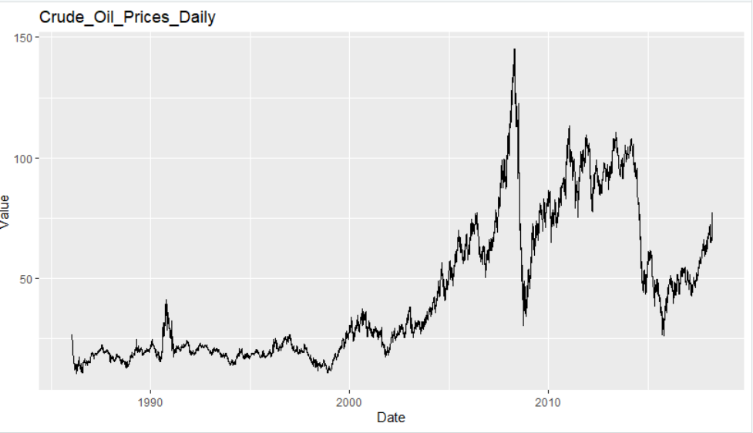
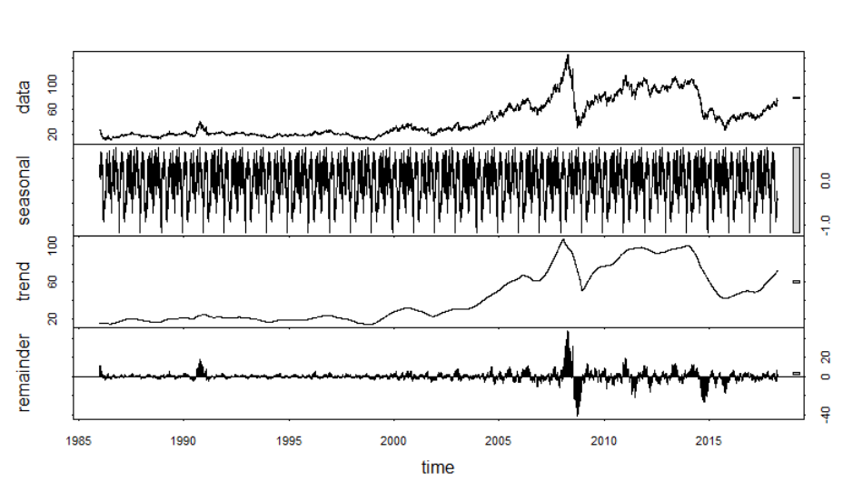
Understanding the data

Slide 4
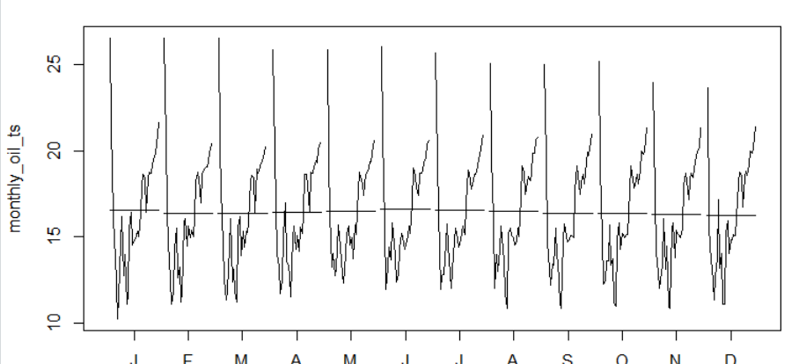
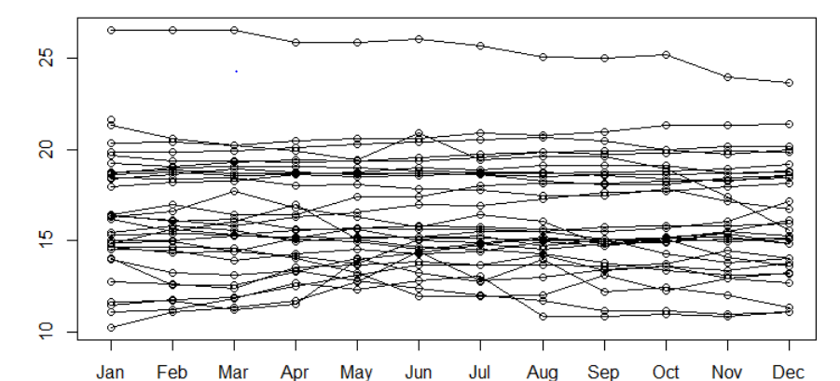
Exploratory data analysis
Monthplot
Seasonplot

Slide 5
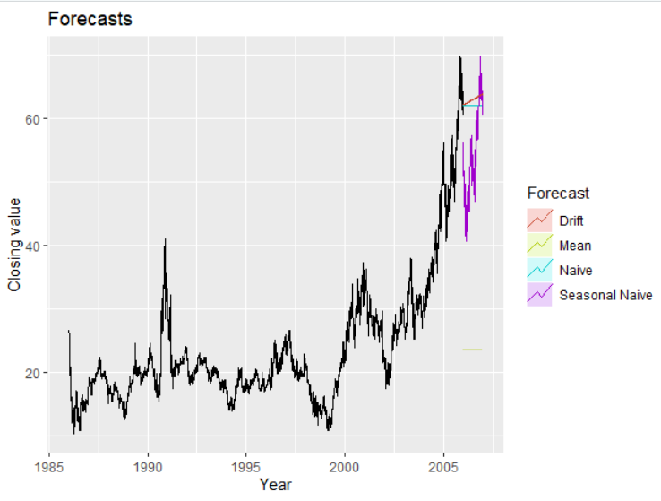
Simple forecasting methods
Average method
Naïve method
Seasonal Naïve Method
Drift method

Slide 6
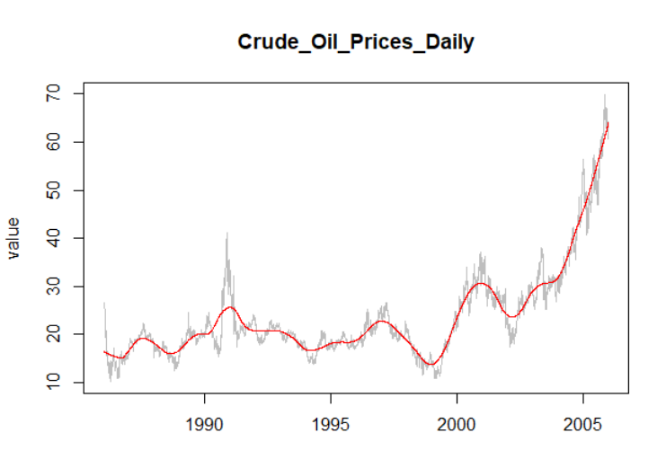
STL Decomposition
Trend-cycle component

Slide 7
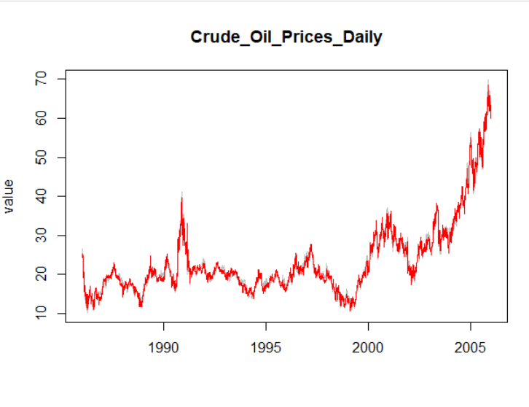
Seasonally adjusted plot

Slide 8
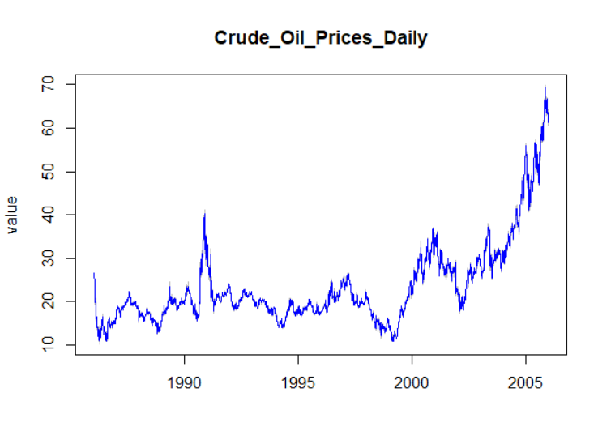
Moving Average

Slide 9
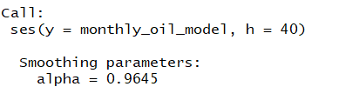
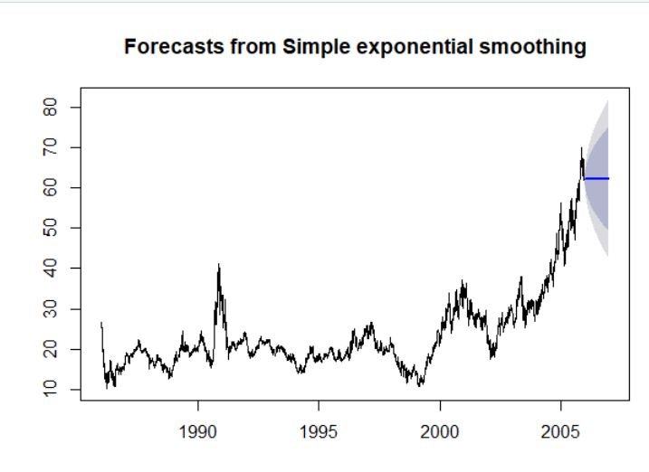
Simple Exponential smoothing
Smoothing parameter
Plotting forecasted data

Slide 10

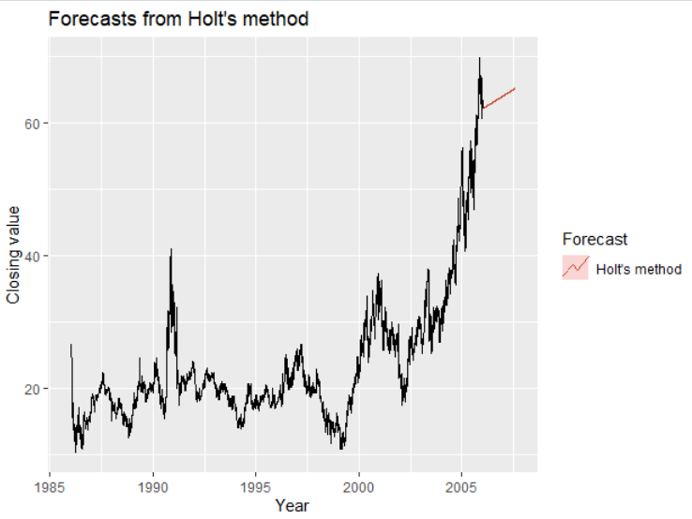
Holt’s linear trend
Parameter
Plot

Slide 11
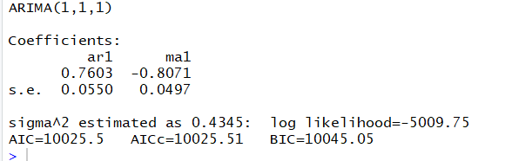
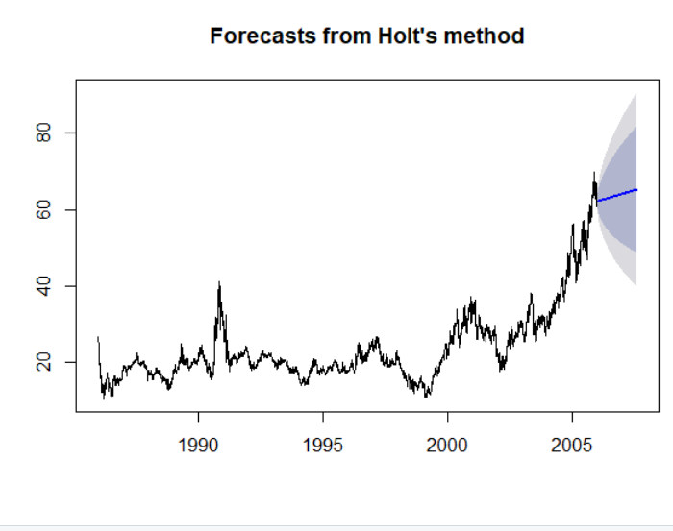
Arima model
Autoregression AR(p)
Moving average MA(q)

Slide 12
challenges
Formatting the data into correct format was difficult as we were dealing with daily values not monthly or yearly values.
Formatting date field was the major hurdle.

Slide 13
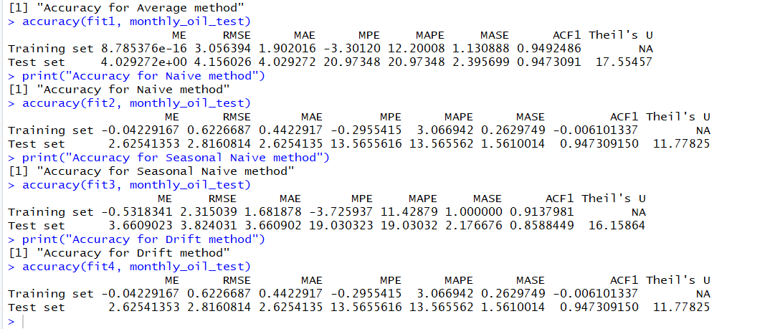
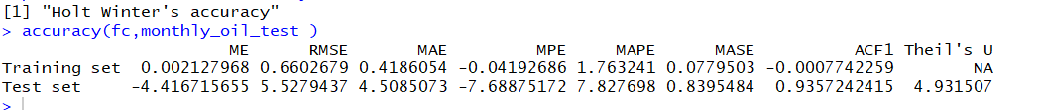
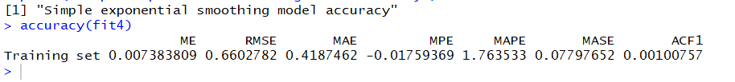
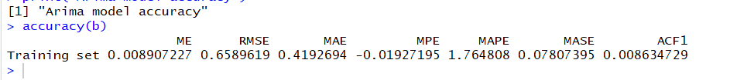
conclusion

Slide 14

THANK YOU

